Slide 1

Predicting Future Energy Demand
This Photo by Unknown Author is licensed under CC BY

Slide 2
Group - 06
1. Md. Milkan Ahmed - 021 221 063
2. Suvom Karmakar - 021 221 027
3. Sadia Islam Nupur - 021 221 060

Slide 3
Table of content
Introduction
Why GDP per Capita?
Regression Method
Code Overview
Working Principle of The code
Results and Analysis
Limitations and Future Work
Data Sources
Conclusion

Slide 4


Objectives
This study aims to utilize numerical analysis, specifically regression methods, to predict Bangladesh's energy demand up to 2050.
Compare predictions with published projections and energy policies.
Accurate forecasting of energy demand is crucial for developing long-term power generation plans.
Analyze the relationship between economic indicators (GDP per capita) and energy demand.

Slide 5
Why GDP per Capita?
Higher GDP per capita generally indicates a higher level of industrialization, which increases the demand for power to run industrial processes.
As people's income rises, they tend to spend more on appliances, electronics, and other energy-consuming goods and services, leading to higher electricity demand.
Economic growth often leads to population growth, and a growing population with a higher GDP per capita translates to a greater demand for residential and commercial buildings, which require heating, cooling, and lighting.

Slide 6
Regression Method
Regression analysis is a statistical technique used to model the relationship between variables.
Cubic regression utilizes a third-degree polynomial equation (y = a_0 + a_1x + a_2x^2 + a_3*x^3) to model curvilinear relationships between variables.
Pros & Cons of the Cubic Regression:
Pros | Cons
Captures complexities, flexible, improved representation of data trends. | Overfitting risk, complexity in interpreting individual coefficients.

Slide 7
Working principle of the code
The code performs cubic regression to predict GDP per capita and power usage.
For GDP per capita prediction, it uses historical data (x_gdp and y_gdp) and applies cubic regression (A_gdp and b_gdp). Predictions are made for the years 1970 to 2050 (prediction_years_gdp).
For power usage prediction, it uses historical data (x_power and y_power) and performs cubic regression (A_power and b_power).
The code then plots the GDP per capita and power usage data on a single graph, including the predicted values for both variables until 2050.

Slide 8
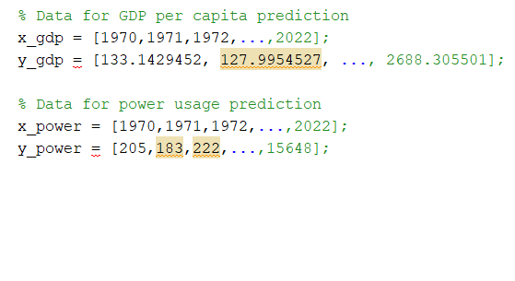
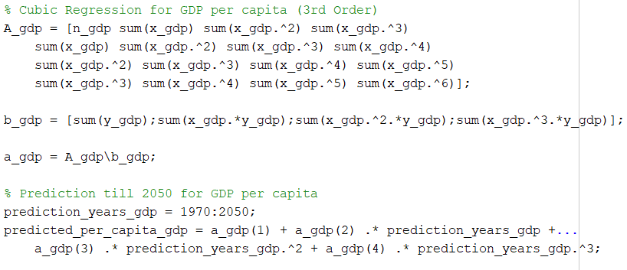

Code Overview
(Data Loading and Preprocessing)
(Cubic Regression for GDP per Capita)

Slide 9
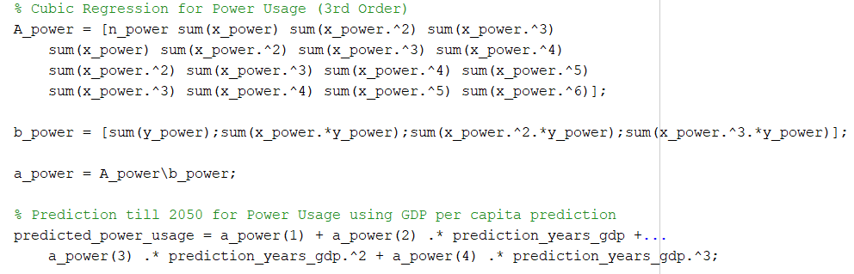
Code Overview
(Cubic Regression for Power Usage)

Slide 10
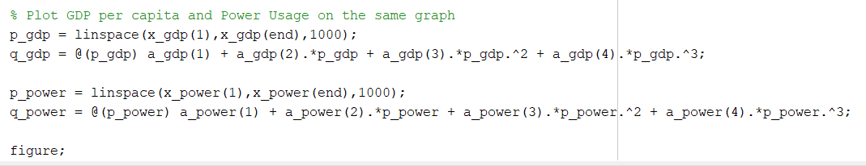
Code Overview
(Plot GDP per capita and Power Usage on the same graph)

Slide 11
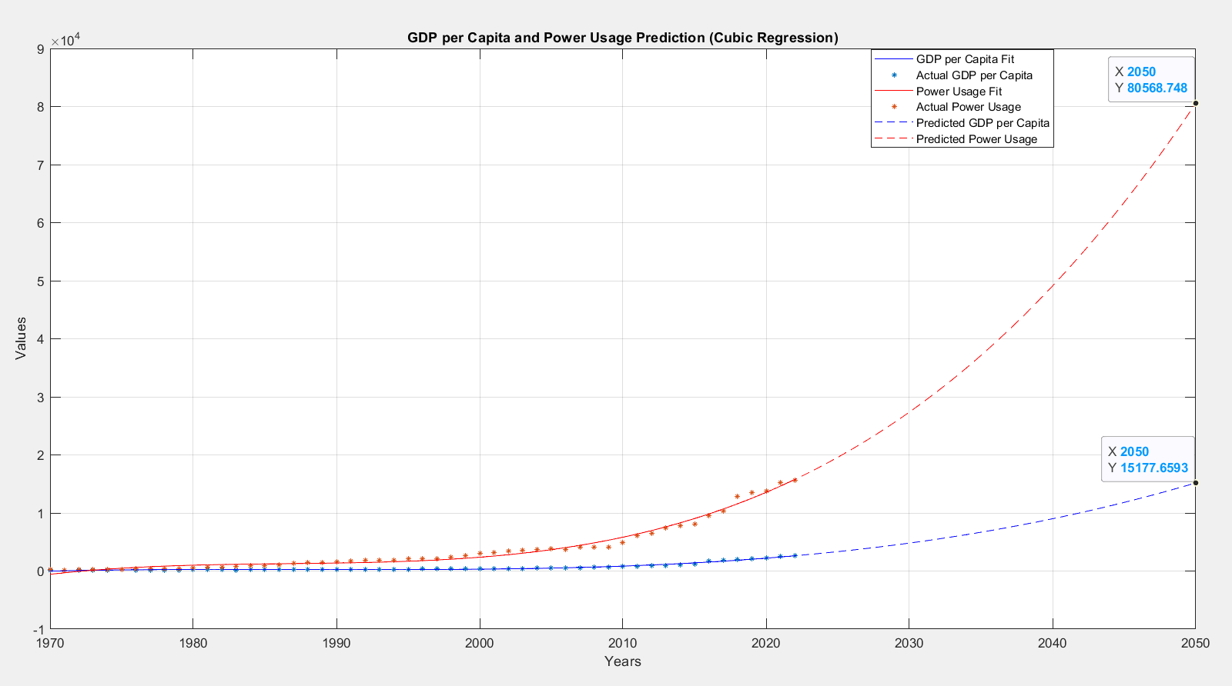
Results and Analysis

Slide 12
Results and Analysis
From Analysis | From Source
The code predicts the power demand in 2050 for Bangladesh to be 80568.78 MW. | The Integrated Energy and Power Master Plan (IEPMP) 2023 concluded that the system capacity should be 84600 MW in 2050.
The code predicts the GDP per capita of Bangladesh in 2050 to be $15177.65. | According to Statista.com, the GDP per capita of Bangladesh in 2050 is projected to be $13927.27.
The results from the code are reasonably accurate compared to other authoritative sources, with some deviations.

Slide 13
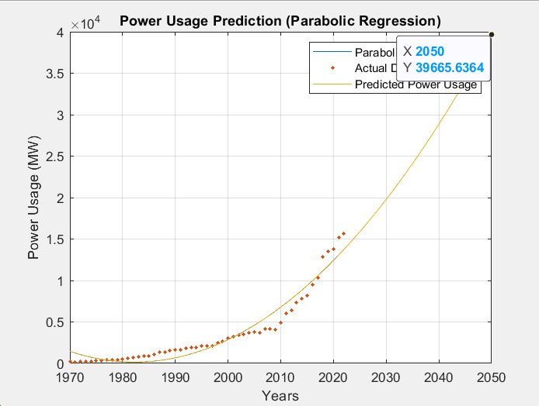
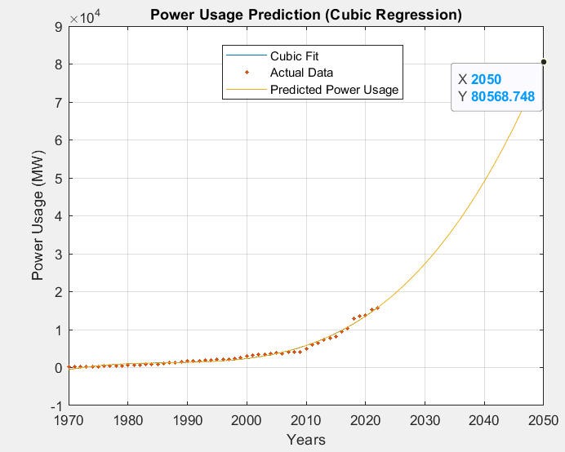
Results and Analysis
(Parabolic Regression)
(Cubic Regression)

Slide 14
Limitations & Future work
The study assumes a direct relationship between GDP per capita and power demand, but other factors like technological advancements, energy efficiency measures, and policy changes can also impact energy demand.
The cubic regression model may not capture all the complexities and nuances of the relationship between GDP per capita and power demand.
Future work could include incorporating additional socio-economic and demographic variables, exploring more advanced machine learning techniques, and updating the model with the latest data as it becomes available.

Slide 15
Data Sources
World Bank Data (GDP per capita, Power Usage)GDP per capita data: https://data.worldbank.org/indicator/NY.GDP.PCAP.CD
Power consumption data:
https://bpdb.portal.gov.bd/sites/default/files/files/bpdb.portal.gov.bd/page/771c9a89_a06c_4c2f_9b8c_699d17ed769a/2024-01-03-06-02-dda85c69e3462d6de89b6486edd08779.pdf
World Energy Outlook reports:
https://www.iea.org/reports/world-energy-outlookGovernment publications
Data description and time period covered:
GDP per capita (current US$) and Power consumption (kWh per capita) data from 1970 to 2022.

Slide 16
Conclusion
This project demonstrates the application of numerical analysis techniques, particularly cubic regression, in forecasting Bangladesh's energy demand based on GDP per capita.
The results provide valuable insights for policymakers and energy planners in developing sustainable strategies to meet the nation's future energy needs.
By accurately predicting energy demand, Bangladesh can better prepare for the required generation capacity and infrastructure investments.
The study highlights the importance of considering socio-economic factors in energy demand forecasting and the potential of numerical analysis techniques in this domain.

Slide 17
Thank you

